Slide 1
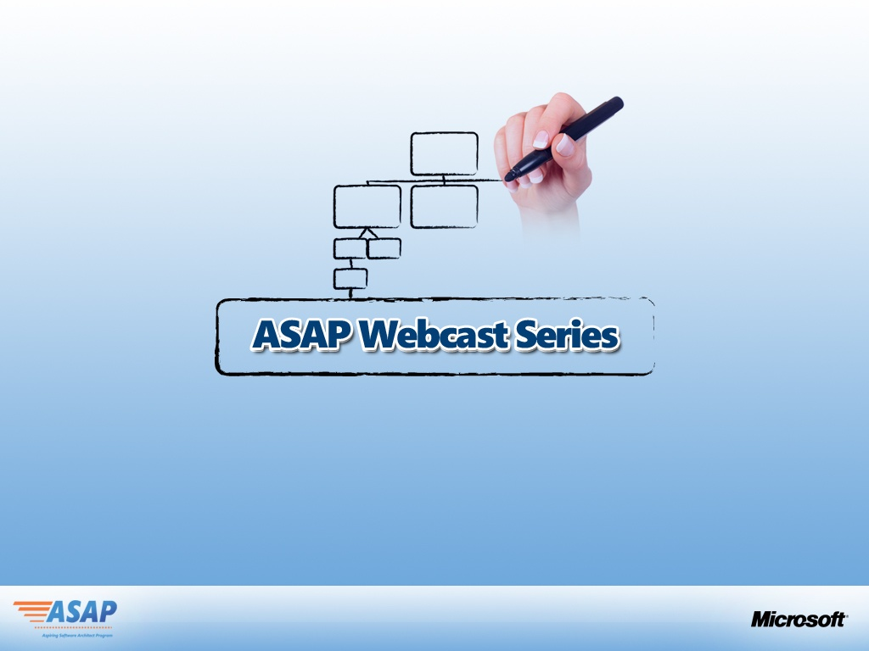
MOSS Solution Architecture
Presented by:
Vinod Tharakan
Founder and Director
BayOne Infotech
Hosted by:
Vikram Rajkondawar
Architect Advisor
Microsoft Corporation
Notes:
Live meeting

Slide 2
Agenda
Introduction to ASAP
Role of an Architect
What is SharePoint – Conceptual View
Functional Components of SharePoint
SharePoint as a Application Development Platform
Role of a MOSS Solution Architect
Organizational Solution Areas – Applying MOSS
Example MOSS Solution Configurations
Complex eGovt Solution Framework – On MOSS

Slide 3

Indian IT Architect Needs
“MOSS Platform is complex to Build Solutions.
How do I know solutions built on MOSS Platform”
“MOSS - HTML Output is terrible
How do I get a different HTML Output.”
“Pls. consider that architects build applications other than business apps with the Microsoft Platform. It would be great to attend a session that shows us how to implement something ... “
“Can we have MOSS architect sessions which can go in depth?”
“Quality Attributes : How do we implement the ability attributes defined and factor it in our design ?”
How can we learn from some of the Best Practices implemented /executed so far on MOSS.

Slide 4

Purpose of this Program
The purpose is to develop architecture and design skills required by individuals to design solutions, on Microsoft Office Sharepoint Platform and get the “abc” of architecture thinking for MOSS based Solutions.
This program is designed to take the senior Developers with 3-5 years of experience on .net to the Next Level of what it takes to become an Application Architect

Slide 5

Architect Maturity Path and Target Audience
Junior Developer (1-3 yrs)
Senior Developer (3-5 yrs)
Application Architect (5-9 yrs)
Solution Architect (9-15 yrs)
Enterprise Architect (15/20 + yrs)
Enterprise Architect
Solution Architect
Application /Infrastructure
Architect

Slide 6
What are the key Objectives
Understand the “abc’s” of Architectural thinking by interacting with a group of Architects who have Architected MOSS Based implementations.
Understand the Best Practices for various kinds of MOSS Projects
Understand the Design/Model aspects of MOSS Platform
Focus on the Critical Success Factors of a typical MOSS project during the various phases of a project lifecycle
Role of an Application Architect throughout the MOSS project

Slide 7

How do we implement this?
Hear it from the ones who have mastered the art !!!
Talk to the Application Architects who have been there done that !!!
Collect best practices,
guidelines, tips and tricks,
invite them for the show we host
Program to consist of 9 modules covering aspects from Information Architecture of a MOSS Solution to Deployment of MOSS Solutions on a farm
Inviting Senior Architects for Partners for Content Creation and Delivery

Slide 8
How does the Program work
Consists of 2 hrs sessions on Live Meeting broadcasted in India
Session are going to be a dialogue between 2 individuals (MS speaker and the selected Architect from SI) to inculcate architecture thinking during various phases of a MOSS project
Sessions consists of Core Architectural thinking topics for Senior developers to move to the App. Arch space
Sessions are going to focus on the Best Practices, Lessons Learnt, Pit Falls, Architecture Guidelines of a MOSS Solution
Present a unique case study in each session talking about Architectural Aspects of the MOSS Solution
Demonstrate Design samples of the MOSS Solution

Slide 9



What does this program contain
Website for information download
9 sessions – 2 hrs each
Case Studies Walk Thru
Architect Contest + prize
Certification for program Participation

Slide 10
Key Take Aways
What it takes to be a Application Architect on MOSS Platform
Understanding and using the right set of tools/ technologies/ design patterns/ architecture decisions to implement a successful MOSS project
9 sessions 8 Great Case Studies demonstrating some complex solutions
Understanding undocumented Best Practices/References and Lessons Learnt for MOSS Implemtations
Hear some of the best MOSS Architects in the Country

Slide 11
Contest Case Study
The Problem (http://www.microsoftasap.com)
The requirement is to architect the next generation Knowledge Management (KM) System for IT
Services companies on the MOSS platform. By leveraging various tools in SharePoint 2007 we
can create an environment conducive to sharing, using and reusing knowledge. The KM could be around entities such as Employees, Customers, Suppliers, Products, Projects etc.
There are limitations on the present MOSS out of the box platform to implement a Web 2.0
system. Some functions the KM system must address are listed below:
- Idea generation and Management
- Project Collaboration & Management
- Social Networking within the Organization
- Technical Knowledge Base
- Employee Information/Skills Matrix
- Problem Resolution
- Next generation Collaboration around Pre-Sales RFP responses etc

Slide 12
ASAP Contest – MOSS Solution Components
MOSS Function | Description
Lists/Libraries/Sites | Architecture to configure MOSS Lists/Libraries as the basic data store , Document Libraries Blogs and Wiki’s - Buckets of Data in Sites.
360 Degree Page View | A key objective of the solution should be the ability to present information in a 360 Degree View around any entity selected by a User. E.g. When viewing details of an Employee, the User should also have access to the Projects the Employee is associated with, All tasks/issues/bugs assigned to the Employee, all documents/blogs/ wiki’s published by the Employee, skills matrix of the Employee etc.
InfoPath Forms | For any Data Capture required from Users, an integrated InfoPath 2007 Form should be used
MOSS BDC for Back End Data Access | When implementing such a KM solution there will be a need for presenting Transactional Data from existing Back End systems like SAP, Siebel etc. - The BDC Functionality of MOSS can be leveraged for this requirement
Search | The MOSS Logical Design should support comprehensive search against the KM system, as well as search within the 360 Degree Page View of any Entity for which this is enabled. The search should also support unstructured data such as Documents managed in Document Libraries.

Slide 13
Contest Case Study - Criteria

Slide 14
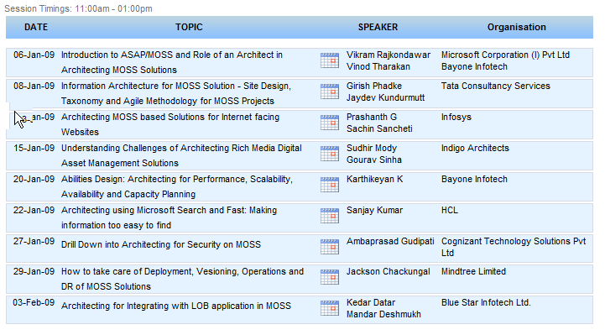
ASAP - Agenda
http://www.microsoftasap.com/agenda.aspx

Slide 15
Let's look at what does an Architect do anyway?

Slide 16
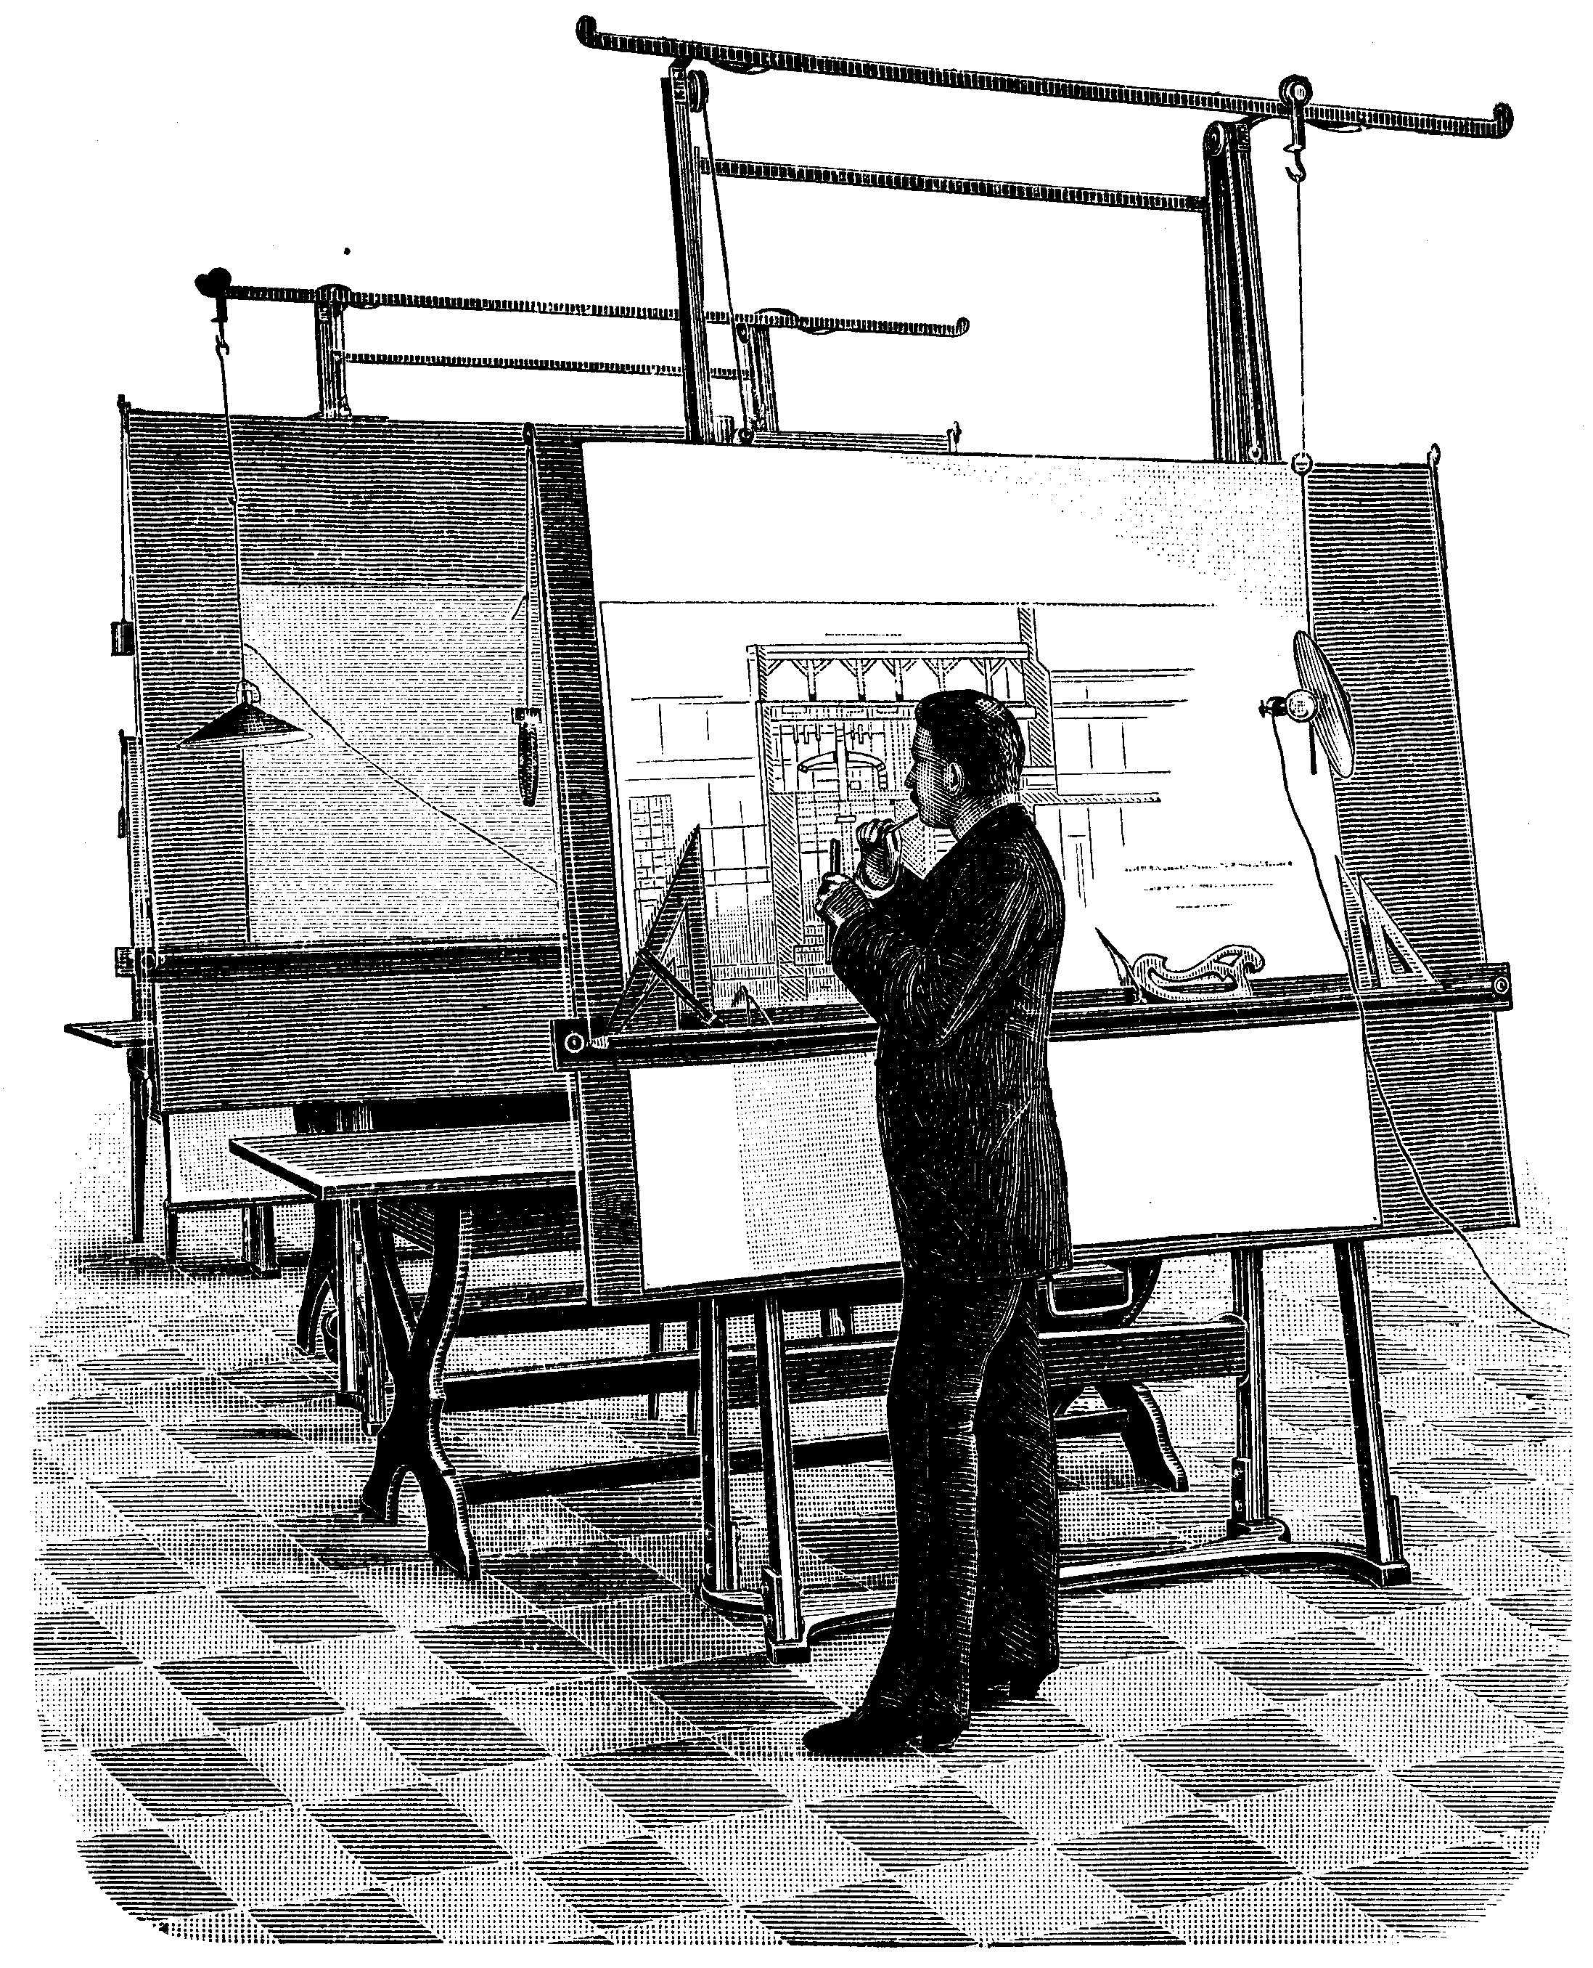
Architecture as a profession
New York City – 1857
Thirteen powerful men—friends of presidents, capitalists, intellectuals, and architects—emerged from horse-drawn carriages to gather together with a singular purpose: to elevate the practice of architecture to a profession in its own right.
The Software Architect’s Profession Marc & Laura Sewell
Notes:
16

Slide 17
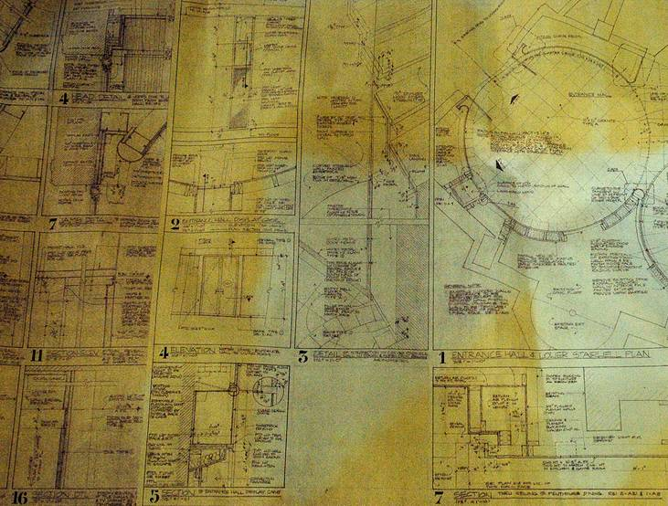
Architecture is an idea, a plan about what the solution that will be built.
Your job is to create an architecture that will meet the need
To collaborate effectively you will need to communicate the architecture to different audiences using a variety of tools, media and means.

Slide 18

What problem are we solving?
What are the practical limits of the solution?
How good does the solution need to be?
What resources do we have to build the solution?

Slide 19
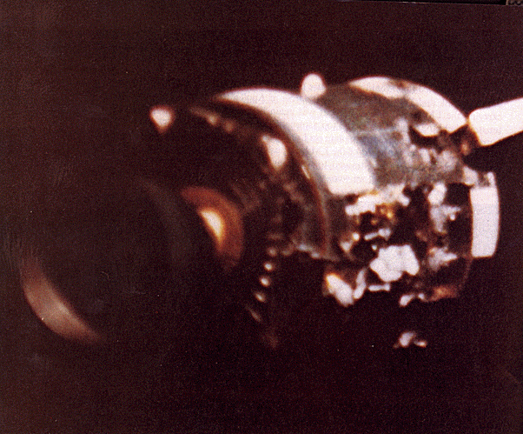
Solve the right problem
Requirements are the way we define the problem we are trying to solve.
To get Apollo 13 home would require a lot of innovation… I certainly agree that without the splendid people in Mission Control, and their backups, we'd still be up there. - Commander Jim Lovell
“Houston, we’ve got a problem” The Apollo 13 Service Module after it was released from the Command Module and set adrift in space

Slide 20

Practical limits
Constraints limit the solution in some practical ways. These limits include time, money, technology, legacy systems etc.
“The Lunar Module was designed to support two men for two days. Now it was being asked to care for three men nearly four days.”
- Commander Jim Lovell

Slide 21
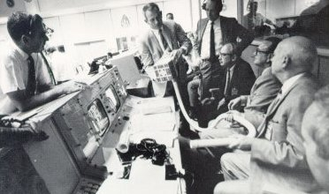
How good is the solution?
The solution must perform well, be secure, be robust and easily managed these characteristics are considered non-functional requirements
“We cut down to six ounces each per day, a fifth of normal intake, and used fruit juices; we ate hot dogs and other wet-pack foods when we ate at all”
- Commander Jim Lovell

Slide 22

Available resources
Resources include people, technology, legacy systems, technical know-how etc.
“They had thought up a way to attach a CM canister to the LM system by using plastic bags, cardboard, and tape- all materials we had on board. Jack and I put it together: just like building a model airplane”
- Commander Jack Lovell

Slide 23

“Find purpose, the means will follow. “
- Mahatma Gandhi
Becoming an architect is a journey toward becoming one who dreams of the solution rather than the one who builds it
Notes:
Not a Week long course of becoming and architect but I would say it’s
and it’s a journey.
So that we learn from people who has done this.
That’s one on the basic premise to invite the parter architects and see how the larger Aspiring community can benefit.

Slide 24
Polls

Slide 25
What is SharePoint?
SharePoint is Microsoft's Portal or Website Development Platform
SharePoint is available as WSS 3.0 which is an add-on feature of the Windows Server and MOSS 2007 which is a Superset of functionality licensed separate
SharePoint can be used to deploy External Facing Public Websites, Internal facing Web Portals (Intranet) and external facing Portals (Extranet)
SharePoint supports the inclusion of any Custom Developed Web applications within its framework, and also the embedding of Custom Developed ‘Web-parts’ into SharePoint Sites
Web Parts are content “containers” used to display information on a site. Web Parts can be used to arrange text, calendars, images, Document Libraries, other customized Web Content or applications

Slide 26
SharePoint Anatomy
Web Application
Basic structure for hosting
SharePoint site collections.
Site Collection
Container for multiple hierarchical
SharePoint sites; basic unit for
Management.
Web/Site
Basic structure that contains
content such as document libraries
and lists.
Shared Service Provider
MOSS component that hosts
common application components
and settings.

Slide 27
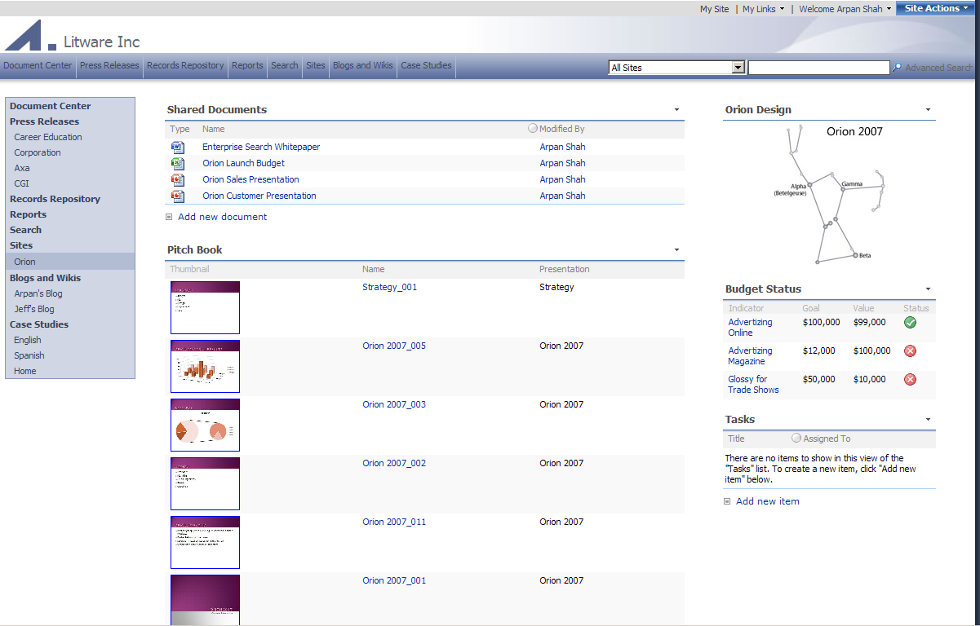
SharePoint Site Anatomy
Documents Library
Image Web Part
KPI Web Part
PPT Slide
Library
Task List

Slide 28

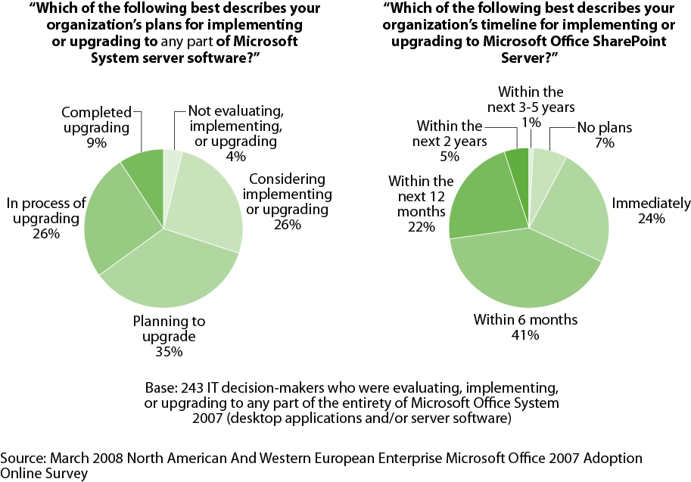
Microsoft Office SharePoint Server Is Poised For Fast Growth
July 2008 “Now Is The Time To Determine SharePoint’s Place In Your Application Development Strategy”

Slide 29
SharePoint Portal Interoperability
SharePoint Portal
SharePoint Application
SharePoint Storage
OOB Web Parts*
Web Page
Other Portal
Other Application
Custom WPs
RSS
Web Services
Web Services
BDC
LOB
System
Database
* OOB Web Parts include:
RSS Web Part, SAP iView Web Part,
Data View Part, WSRP Consumer Web Part,
Page Viewer Web Part, BDC Web Parts, Search Federation Web Parts
**Search protocol handlers can index content from external repositories

Slide 30
SharePoint 2007 Core Functions
Portal
Portal Wide Content Search
Uploaded Files indexed for Search
Business Data Search with BDC
3rd Party Connectors E.g. Filenet
Portal Site Templates
Personal ‘My Site’
Blogs and Wikis
Audience Targeting
Mobile Device Support
Search
Content Management
Business Process Management
Business Intelligence
Web Content Management
Document Management
Records Management
Document Review/Approval
Designing Complex Workflows
Create Web Forms using InfoPath
Create Web Forms Workflows
Report Center for SSRS Reports
KPI Web Parts for Dashboard
Excel Services for Excel Views in the Browser

Slide 31







SharePoint 2007 Features
Server-based Excel spreadsheets and data visualization, Report Center, BI Web Parts, KPIs/Dashboards
Docs/tasks/calendars, blogs, wikis, e-mail integration, project management “lite”, Outlook integration, offline docs/lists
Collaboration
Business
Intelligence
& Business - Process
Platform
Services
Rich and Web forms based front-ends, LOB actions, pluggable SSO
Enterprise Portal template, Site Directory, My Sites, social networking, privacy control
Business Forms
Workspaces, Mgmt,
Security, Storage,
Topology, Site Model
Portal
Content
Management
Search
Integrated document management, records management, and Web content management with policies and workflow
Enterprise scalability,
contextual relevance, rich
people and business data search

Slide 32









SharePoint Specialist Skills
SharePoint Business Analyst
SharePoint Infrastructure Specialist
Business
Intelligence
Collaboration
SharePoint Creative Designer
Business Forms
Platform Services
Portal
SharePoint Developer(s)
Content
Management
Search
SharePoint Trainer
SharePoint Architect
Business
IT & Dev

Slide 33
Role of a MOSS Solution Architect
Analyze the Business Requirement and break it down into functional modules and solution phases as envisioned
Map the Business Requirement to a logical solution utilizing ‘Out of the Box’ MOSS functional modules and list the missing functional areas
Analyze the points of MOSS Customization required within the solution for addressing the missing functional areas
Apply the 80/20 rule to make a feasibility assessment on the appropriateness of MOSS as the solution platform
Engage with a MOSS Technical Architect to create the MOSS Logical Design Document and estimate effort and costs for the Solution Implementation
Present the solution options based on MOSS for review and approval, by also addressing the impact of MOSS to future enhancements required as per any envisioned solution roadmap
Contribute to the Training and Operational Support required to maintain the solution in production

Slide 34

An Organizations Areas of IT Needs – Where MOSS Can play a Role
External Entities that IT should support Collaboration with
Integration Supported through Customization
Customers
Dealers/ Retailers
Suppliers/ Partners
Currently these areas are mostly addressed through Email, Phone Calls & Faxes
Core IT – ERP Domain
Finance/Accounting
Website – Business Information
Extranet – Business Enquiry/Ordering
Intranet/ Extranet – Helpdesk/Service/Support
Functional Areas where solutions on WSS/MOSS can be offered
Inventory
Analytic Dashboards
CORE IT SYSTEMS
Organizational Pain Areas
How IT Can Help?
Data Warehouse
WSS/MOSS/SSRS
Manufacturing
Supply Chain
Analytic Dashboards
HR / Payroll
Sales – SFA & Collaboration
Purchase – Collaborate & Automate, RFP etc
Service –Pre/Post-Sales, Maintenance/MRO
Admin – Document/ Records Mgmnt, Audit
Functional Areas where solutions on WSS/MOSS can be offered
Transaction Based, typically very little customization.
Internal Entities that IT should support Collaboration For
Corporate Wide Employees
Inter-Branch/Site Collaboration
Outstation/ Mobile Employees
Integration Supported through Customization
Currently these areas are mostly addressed through Email, Phone Calls & Printouts

Slide 35
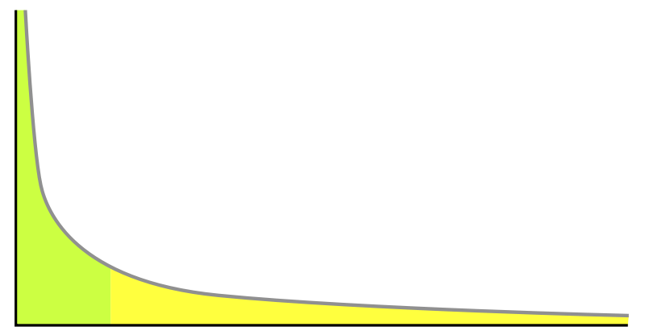
The Long Tail
Tail
The set of products that caters to
more specific user segments.
Popularity
Products
Head
The set of popular products that
caters to broad user segments.

Slide 36
IT Functions implemented on MOSS
Web Portals
(Structured content)
Highly Structured Enterprise
Repositories
Tail
The set of applications and
unstructured content (typically)
that caters to teams.
User Base
Departmental solutions
(Structured & Unstructured)
Collaboration Team Sites
(Unstructured content)
Empowerment
Head
The set of applications and structured
content (typically) that caters to large
audiences.

Slide 37
Typical IT Solutions addressed with MOSS
Regulatory
Compliance
Repository
Extranet
Collaboration
Site
Sales
Division
Portal
R&D
Community
Corporate
Web
Presence
Knowledge
Management
Portal
Employee
Portal
Geneva
Office
Site
Business
Intelligence
Dashboard
Project “X”
Site
Team “ABC”
Site
Custom
SAP
Front-End
My “Facebook”
Notes:
Vikram
It challenges. We have internally.
- This is spagetti infrastructure.
You have Facebook/ emp portal/project site. IT web apps built on different technologies.
It leads to Higher cost/deployment cost/ training cost. Different development Strategies/ Different deployment strategies.
This the world we live in for most part.
That’s what I call the real world.

Slide 38
SharePoint Strategy and Roadmap
Corporate
Web
Presence
Single Business Productivity Platform leading to common:
End-user Experience
Rich Integrated Capabilities
Toolset and Development
Deployment and Management
Employee
Portal
Knowledge
Management
Portal
Regulatory
Compliance
Repository
Users
Sales
Division
Portal
Custom
SAP
Front-End
Extranet
Collab
Site
R&D
Community
Geneva
Office
Site
Business
Intelligence
Dashboard
My
“Facebook”
Team “ABC”
Site
Project “X”
Site
Corporate
Departments
Teams
Empowerment

Slide 39
MOSS Architect Strategy
Enterprise solutions (Head)
Which solutions do you want to move to your SharePoint Platform?
What is your migration and/or co-existence strategy?
What is your training and adoption strategy?
Repeatable, configurable solutions or one-time deployments?
Corporate
Web
Presence
Employee
Portal
Knowledge
Management
Portal
Regulatory
Compliance
Repository
Users
Sales
Division
Portal
Custom
SAP
Front-End
Extranet
Collab
Site
R&D
Community
Geneva
Office
Site
Business
Intelligence
Dashboard
My
“Facebook”
Team “ABC”
Site
Project “X”
Site
Corporate
Departments
Teams
Empowerment

Slide 40
MOSS Architect Strategy
Self-service solutions/platform (Tail)
Moderate with workflow?
What templates and features do you make available? Allow customizations via SharePoint Designer?
What is your Service Level Agreement with users?
What is your training and adoption strategy?
Corporate
Web
Presence
Employee
Portal
Knowledge
Management
Portal
Regulatory
Compliance
Repository
Users
Sales
Division
Portal
Custom
SAP
Front-End
Extranet
Collab
Site
R&D
Community
Geneva
Office
Site
Business
Intelligence
Dashboard
My
“Facebook”
Team “ABC”
Site
Project “X”
Site
Corporate
Departments
Teams
Empowerment

Slide 41
SharePoint Application – General Functional Mapping
Solution Back End
Data Management - Lists
Document/File Management - Libraries
Collaboration around an Entity – Custom Site
Process Automation – SharePoint Workflow
Business Logic – Custom .NET Code
Solution Front End
InfoPath Forms Server – Data Entry Forms
ASP.NET Web Forms – Complex Forms with Business Logic
Custom Web Parts - Present Content, Custom App Functions etc
Site Navigation & Security

Slide 42
Employee Data Management SharePoint Solution
Emp Contact List
Custom Data View Web Part to Display Filtered Contact Data by Emp
The Custom Data View Web Part Auto-Filters each List by the Master List Parameter Passed to the Custom SharePoint Page
Emp Doc’s Library
Employee Master List
Emp Vacation Requests
Custom Web Part to Display Filtered Expense Data by Emp
Emp Expenses List
Each Custom Data View Web Part on this Page is filtering the List Records by the Employee ID.
Custom SharePoint Page, related to the Employee Master List
Web Part to Display Emp Contact Records
Web Part to Display Emp Documents like Passport Copy, CV
Web Part to Display Emp Vacation Request Records
Web Part to Display Emp Expense Reimbursement Records
Individual Employees need not have access to the Master List for security purposes, but can see this Employee Profile Page with all their individual profile content.
Note: The Employee can submit new entries into the lists from this page as well.

Slide 43
Customer Data Management SharePoint Solution
Customer Contact List
Custom Data View Web Part to Display Filtered Contact Data by Customer
Customer RFP/Proposal Doc’s Library
Customer Master List
Customer Orders List
Custom Web Part to Display Filtered Orders Data by Customer
Customer Complaints List
Each Custom Data View Web Part on this Page is filtering the List Records by the Customer ID.
Custom SharePoint Page, related to the Customer Master List
Web Part to Display Customer Contact Records
Web Part to Display Customer RFP/Proposal Documents
Web Part to Display Customer Orders Records
Web Part to Display Customer Complaints Records

Slide 44
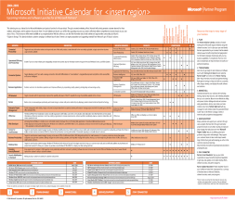
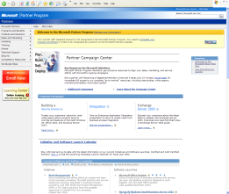





eGovt Line of Business Solution Framework – Built on MOSS
eGovt Dept
Front Office
UI in MOSS
Citizen/Department
Internet Portal Site
in MOSS
Renewal
Application
Module
Cash
Check
Credit Card
eCash/Smartcard
Fund Transfer
Certificate
/ License
PDA’s
Tablet PC’s
Handhelds
Cell Phone
Cash
Check
Credit Card
Fund Transfer
MOSS Workflow Engine
Certificate/License
Application
Driving License / Car Registration / Passport / Visa / Panchayat NOC etc
Fee/Rev
Calculator
Engine
Payment
Processor
Engine
Certificate
Or License
issuance
Certificate
Or License
Renewals
Engine
Audit &
Inspections
Engine
eGovernment Line Of Business Solution Framework
(Supports Integration, Data Access Interfaces and Messaging through Web Services)
Microsoft Servers
Office 2007
MOSS
EPM
Exchange
ERP (Tightly Integrated with Financials GL, AR, AP, SOP, POP)
Windows 2003/2008, SQL Server 2005/2008

Slide 45
ASAP - Agenda
http://www.microsoftasap.com/agenda.aspx

Slide 46
Q&A Thank You!
Take part in our contest and you stand to win an HTC Diamond phone. Go to http://www.microsoftasap.com for more details.

